Slide 1

SANITIZE WORLD E-COM WEBSITE
Moonien Murugen
Madarbakus Hussain

Slide 2
PRESENTATION

Slide 3

On entering the website name on search bar, we enter the homepage.
index.php
From now we can browse into the page.

Slide 4
header.php
The navigation bar is found in header.php.
We can browse on clicking on the different items on the navigation bar.

Slide 5

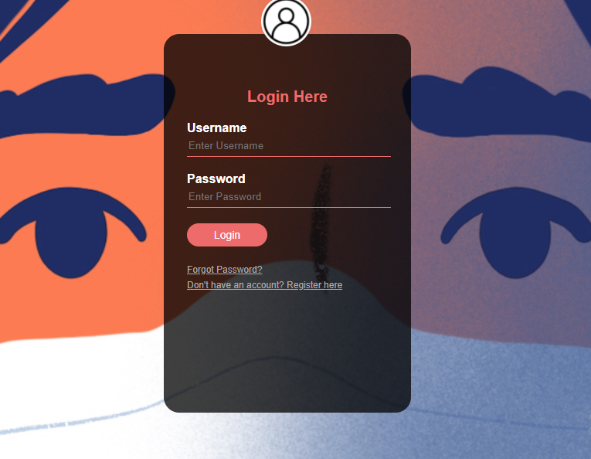

On clicking the log in button, it directs user to login page
login2.php
register.php
If you already have an account or need to register, these Hypertext REFerence(href) will help to access the required page.

Slide 6
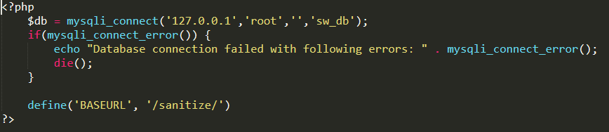
The part to connect the database to the website is found in init.php

Slide 7
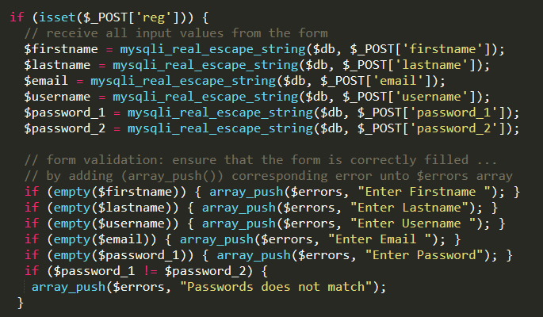
These are the input made on the sign up form (register.php)
While submitting the form, the form validation checks if it is filled correctly and displays those errors on the form itself (connected to errors.php to display errors)
server.php
‘reg’ is the name of the submit button found on register.php

Slide 8
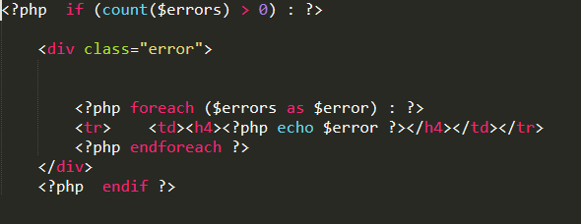
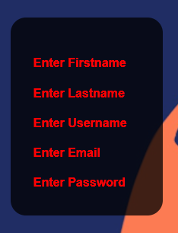
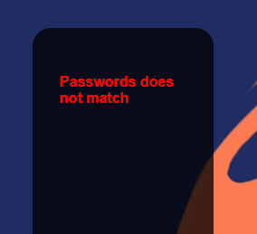
errors.php
When nothing has been filled & register button is clicked
On confirming password, when check is over and there is an error.

Slide 9
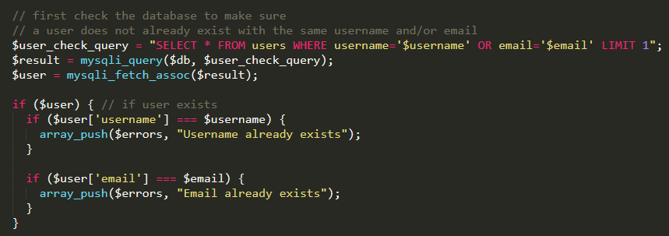
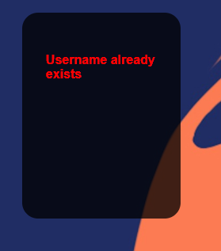
In the register page, on clicking the register button
server.php
After checking if all were inputted correctly, we have to check in the database if there is the same username or same email already inputted by another user and display an error message if it is in the warning panel.

Slide 10
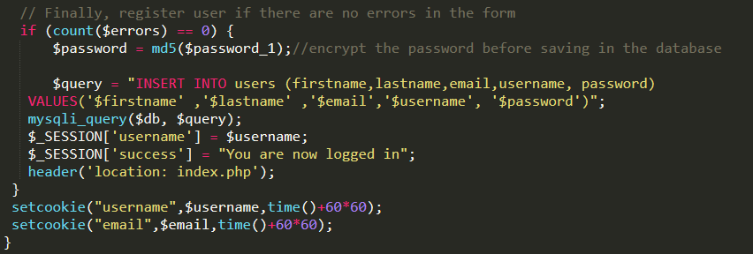

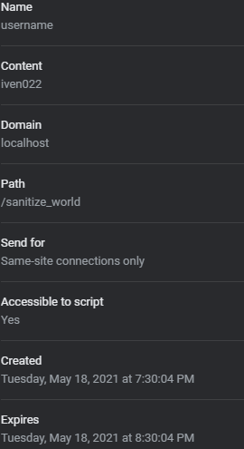
server.php
Account saved in database.
Cookie save for 1 hour.

Slide 11


index.php
The navigation bar has been included on the HOME page(index.php), on the CONTACT US page (contactus.php) and the ABOUT US page(about.php) so as for the buttons to be dynamic. The navigation bar codes have been stored in the ‘header.php’ and using the ‘include() ‘function we can access the 3 pages in which we have included the code.

Slide 12
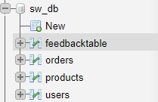
Database creation
First we have created a database called ‘sw_db’ with tables namely:
feedbacktable
orders
products
users

Slide 13
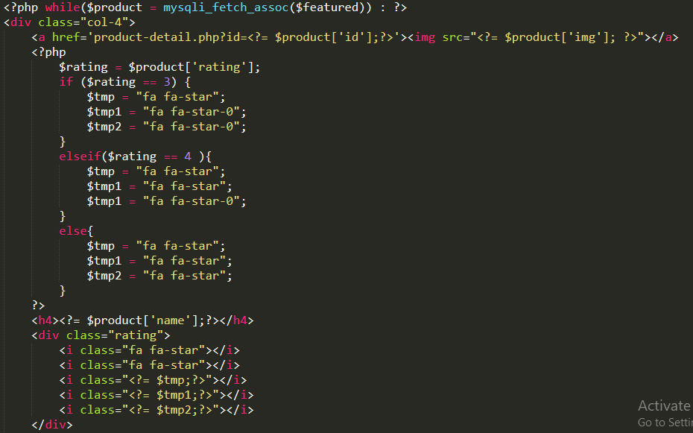
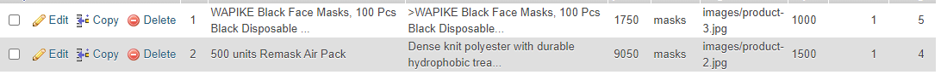
Display
Fetching the data from the database
This code is used to display the products that we can buy on the e-com website.
(index1.php)
ID taken from local database.

Slide 14
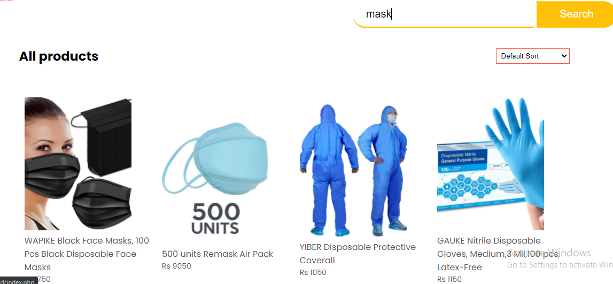
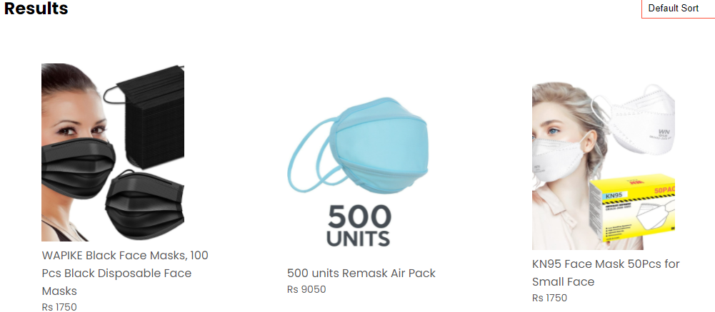
Selection of product and checkout
On the search bar, we enter a keyword to facilitate the product we want
We obtained results due to search bar

Slide 15
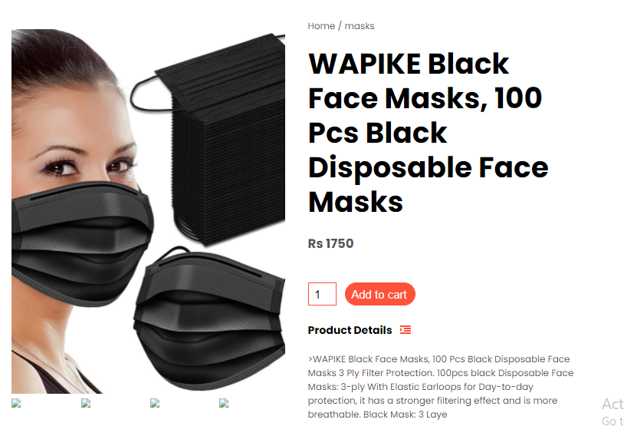
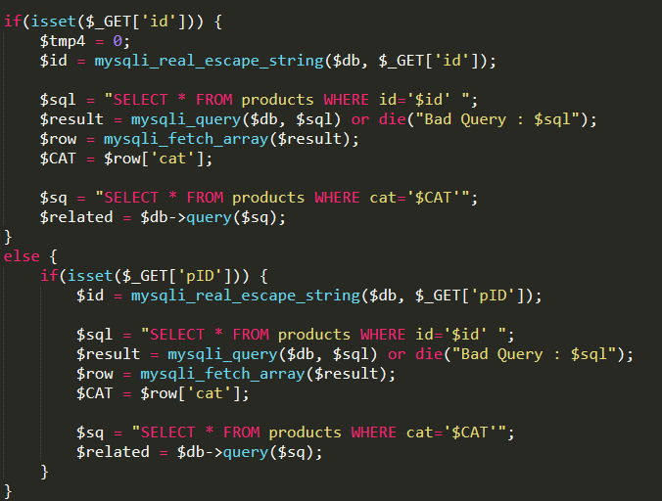
product-detail.php
In the code below, when the product is selected, it searches it by Id and add it to a new variable pID(to know that this id is included in the cart).
Clicking on the product we want & add it to cart

Slide 16

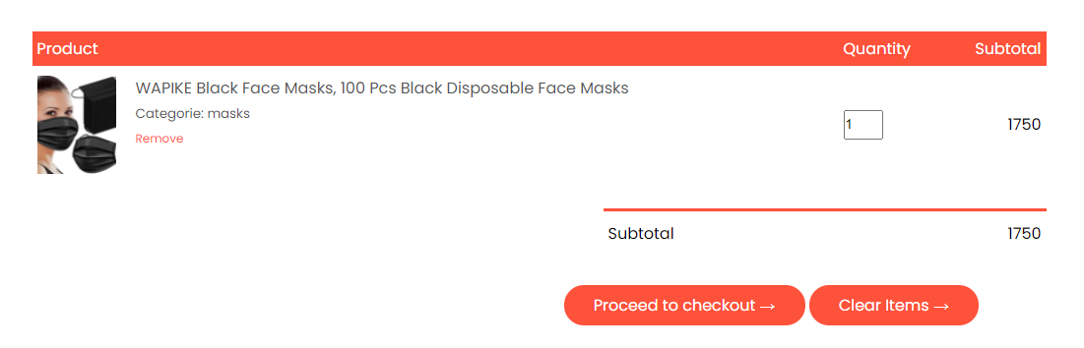
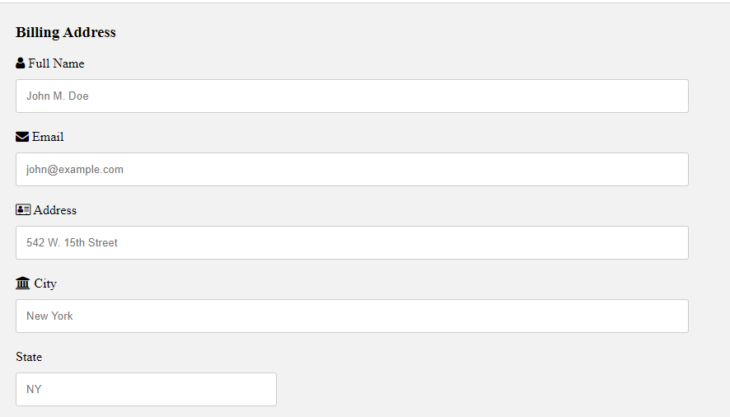
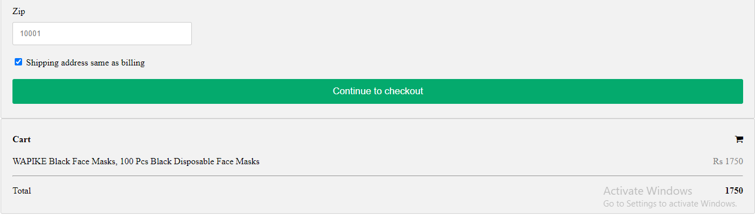
This appears on top of the page with a message
cart.php

Slide 17
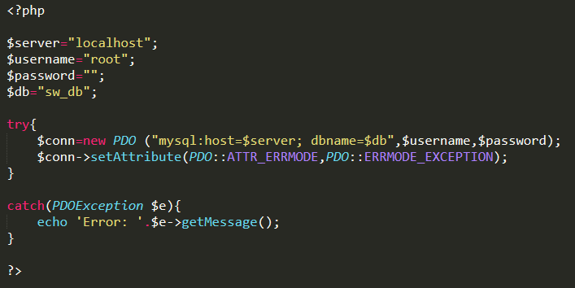
Creating a connection for our contact form using PDO.Using PDO we can switch between different databases and platforms.
contactus.php

Slide 18
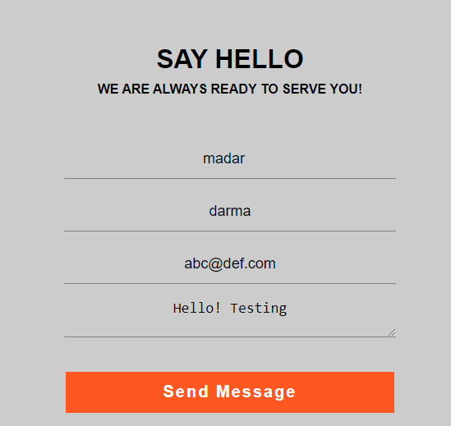
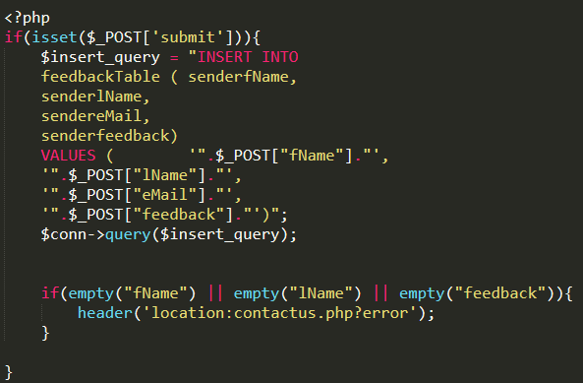
When we send the Message , it will go to our database in the feedback Table and if the entries are empty then it will redirect us to the contact page by using the header() function.
contactus.php
Admin can check feedback on database.

